Slide 1

Basic of C Programming
Concept of Operators - II

Slide 2
Logical Operators -
An expression containing logical operator returns either 0 or 1 depending upon whether expression results true or false.
Logical operators are commonly used in decision making in C programming.
Operator | Meaning | Example
&& | Logical AND. True only if all operands are true | If c = 5 and d = 2 then, expression ((c==5) && (d>5)) equals to 0.
|| | Logical OR. True only if either one operand is true | If c = 5 and d = 2 then, expression ((c==5) || (d>5)) equals to 1.
! | Logical NOT. True only if the operand is 0 | If c = 5 then, expression !(c==5) equals to 0.

Slide 3
Bitwise Operators -
During computation, mathematical operations like - addition, subtraction, multiplication, division, etc are converted to bit-level which makes processing faster and saves power.
Bitwise operators are used in C programming to perform bit-level operations.
Operators | Meaning of operators
& | Bitwise AND
| | Bitwise OR
^ | Bitwise exclusive OR
~ | Bitwise complement

Slide 4
Truth Table
a | b | a & b | a | b | a ^ b
0 | 0 | 0 | 0 | 0
0 | 1 | 0 | 1 | 1
1 | 0 | 0 | 1 | 1
1 | 1 | 1 | 1 | 0

Slide 5
Shift Operators -
Shift Operators are also the part of Bitwise Operators.
The bitwise shift operators move the bit values of a binary object.
The left operand specifies the value to be shifted.
The right operand specifies the number of positions that the bits in the value are to be shifted.
Operators | Meaning of operators
<< | Shift left
>> | Shift right
a = 0001000
b = 2
a << b = 0100000
a >> b = 0000010

Slide 6
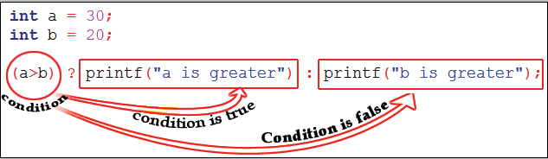
Ternary Operators -
It is also known as Conditional Operator.
The conditional operators in C language are known by two more names
Ternary Operator
? : Operator
It is actually the if condition that we use in C language decision making, but using conditional operator, we turn the if condition statement into a short and simple operator.
Syntax – expression 1 ? expression 2: expression 3

Slide 7
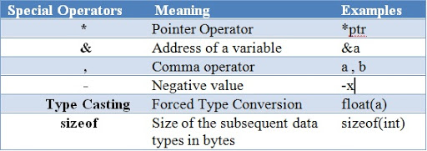
Special Operators -

Slide 8
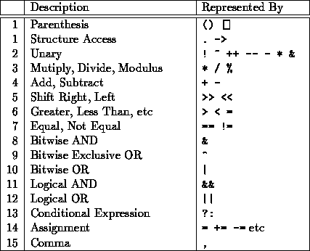
Operator Precedence -

Slide 9
Thank you…!

